Slide 1
Unit IV

Slide 2
Version | Introduced in | Frequency band used | Maximum speed provided
IEEE 802.11a | 1999 | 5 GHz | 54 Mbps
IEEE 802.11b | 1999 | 2.4 GHz | 11 Mbps
IEEE 802.11g | 2003 | 2.4 GHz | 54 Mbps
IEEE 802.11n | 2009 | Both 2.4 GHz and 5 GHz | 600 Mbps
IEEE 802.11ac | 2013 | 5 GHz | 1.3 Gbps
IEEE 802.11ax | 2019 | Both 2.4 GHz and 5 GHz | Up to 10 Gbps
802.11 Protocols
Wi-Fi stands for Wireless Fidelity, and it is developed by an organization called IEEE (Institute of Electrical and Electronics Engineers) they set standards for the Wi-Fi system.
Each Wi-Fi network standard has two parameters :
Speed – This is the data transfer rate of the network measured in Mbps (1 megabit per second).
Frequency – On what radio frequency, the network is carried on. Two bands of frequency for Wi-Fi are 2.4 GHz and 5 GHz. In short, it is the frequency of radio wave that carries data.
IEEE 802.11 –
It was developed in 1997.
Speed is about 2 Mbps (2 megabits per second)

Slide 3
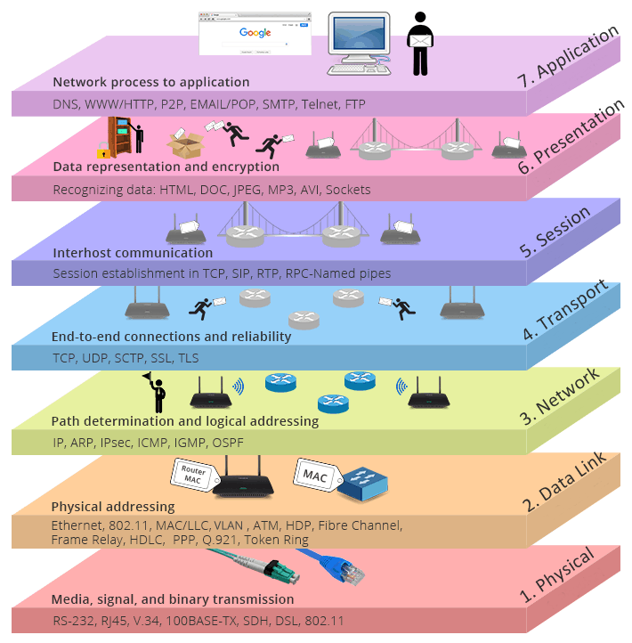
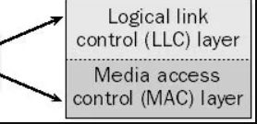
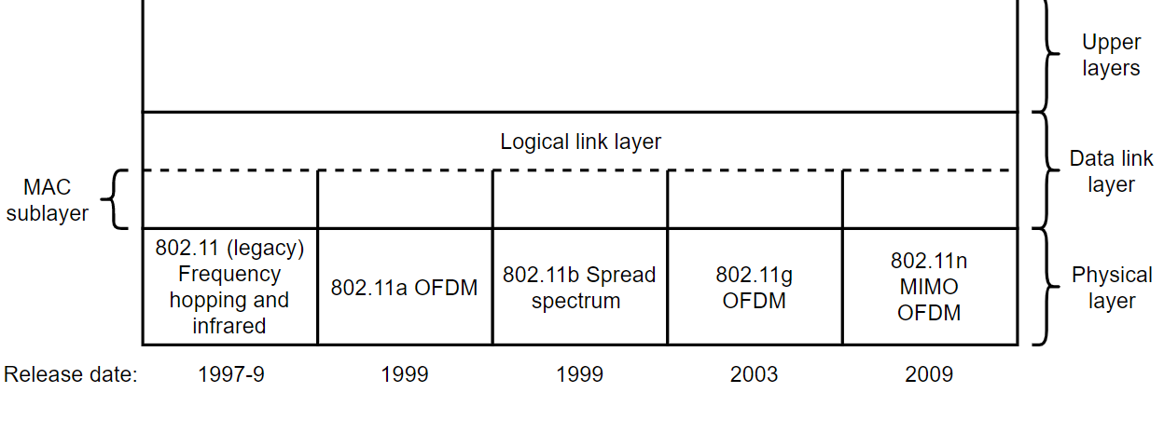
IEEE 802.11 is a set of protocols and standards for executing WLAN (wireless local area network) computer communication in the 5, 3.6, and 2.4 GHz frequency bands.
They're made and maintained by the IEEE 802 or the IEEE LAN/MAN Standards Committee. IEEE 802.11-2007 is the latest base version of this standard. What's more, the 802.11 family is composed of a volume of airborne modulation methods that utilize identical and basic protocol.
The most ubiquitous and widely used versions of this standard are the 802.11g and 802.11b protocols, which were improvements to the earliest standard.
Meanwhile, the first wireless networking standard is the aforementioned 802.11-1997 as well. Regardless the most widely accepted one was the 802.11b, which was then followed by 802.11g and 802.11n.

Slide 4
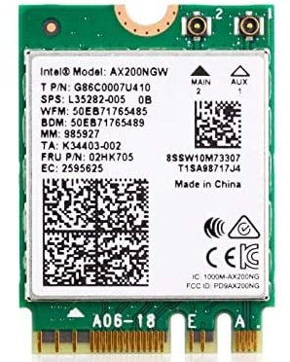
WAP Security issues
Wireless access points are easy to install. As a result, many individuals within companies have taken it upon themselves to set up an authorized access point, without informing the network administrator. Typically, these access points are not protected, which means they can be used by an attacker just as they can by a valid user.
Rogue access points can also be used to lure valid users away from their corporate network. If an attacker can set up an access point with a stronger signal than the valid one, the target’s computer automatically connects to the attacker’s AP.
When a computer connects to an access point, it generally stores the details of that connection locally. The next time the computer is turned on, the wireless network card immediately looks for the connection and re-establishes the connection – without user intervention.

Slide 5
Difference - Promiscuous vs. Monitor Mode
Monitor mode (RFMON) enables a wireless NIC to capture packets without associating with an access point or ad-hoc network. This is desirable in that you can choose to "monitor" a specific channel, and you need never transmit any packets.
Promiscuous mode allows you to view all wireless packets on a network to which you have associated. The need to associate means that you must have some means of authenticating yourself with an access point. In promiscuous mode, you will not see packets until you have associated.
In monitor mode the SSID filter mentioned above is disabled and all packets of all SSIDs from the currently selected channel are captured. Even in promiscuous mode, an 802.11 adapter will only supply packets to the host of the SSID the adapter has joined. Although it can receive, at the radio level, packets on other SSIDs, it will not forward them to the host.

Slide 6
WLAN Authentication and Encryption
WLAN Encryption Methods
Wired Equivalent Privacy (WEP)
Wi-Fi Protected Access (WPA)
Wi-Fi Protected Access 2 (WPA2)

Slide 7
Features of WEP
WEP was introduced as a part of the IEEE 802.11 standard in 1997.
It was available for 802.11a and 802.11b devices.
WEP uses encryption of data to make it unrecognizable to eavesdroppers.
It uses RC4, a stream cipher, for encryption and CRC-32 checksum for confidentiality and integrity
The two widely used standards were WEP-40 and WEP-104.
In WEP-40, a 40 bit WEP key is concatenated with a 24 bit initialization vector, to generate a 64 bit RC4 key.
In WEP-104, a 104 bit WEP key is concatenated with the 24 bit initialization vector, to generate a 128 bit RC4 key.
WEP operates at the data link and physical layer.
It incorporates two authentication methods:
Open System authentication
Shared Key authentication

Slide 8
WPA was initially released in 2003. The Wi-Fi Alliance defined WPA as a response to serious weaknesses found in the WEP protocol.
New updates and features of WPA3 include:
256-bit Galois/Counter Mode Protocol encryption (GCMP-256);
384-bit Hashed Message Authentication Mode (HMAC);
256-bit Broadcast/Multicast Integrity Protocol (BIP-GMAC-256);
an equivalent 192-bit cryptographic strength (in WPA3-EAP enterprise mode);

Slide 9
